Slide 1
What does ‘Well-being’ mean for our future?
Theme of
World Youth Meeting 2018
Notes:
Hello, nice to meet you.
My name is ( ) [Gary].
I am very pleased to be here with you.
Today, I would like to share the theme of the World Youth Meeting, an international event.

Slide 2
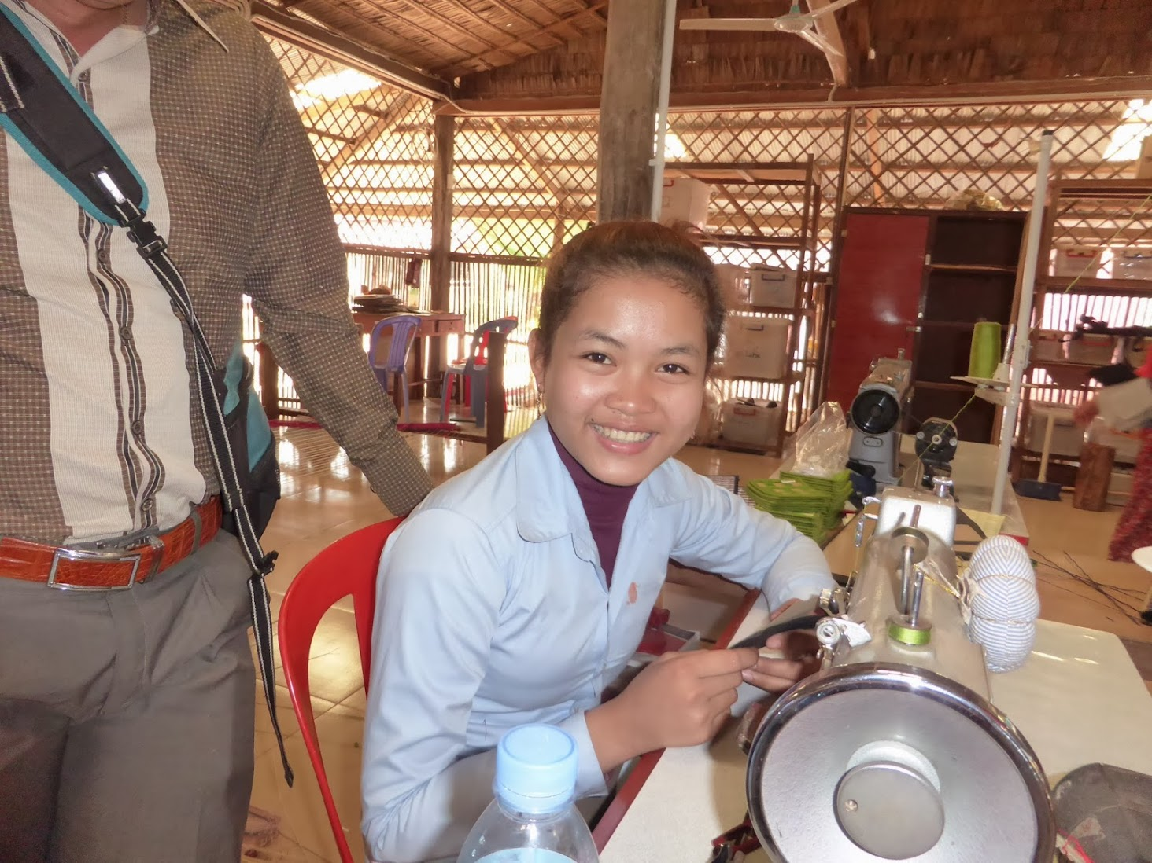
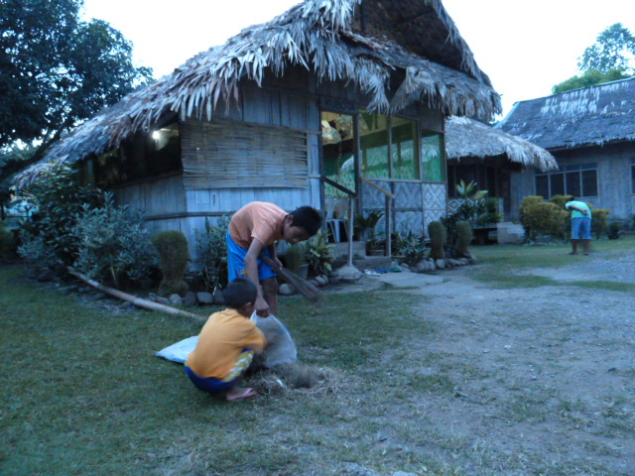
“Well-being” or “Welfare”
Compared to ”welfare”
Notes:
Please look at these pictures.
On the left you can see an orphanage.
On the right, you can see a woman working in Cambodia.
She has escaped from poverty.
You may be more accustomed to the word “welfare” than ‘Well-being’.
As you know the concept of ‘Welfare’ is related to these two photos.
From the word “Welfare” you may imagine those who are in need.
Children in an orphanage in the Philippines.
Or women, who have a serious need for help to survive in Cambodia.
Yet the keyword of this year’s WYM theme is “well-being”
What is “well-being?”
“Well-being” is now considered a more appropriate word than ‘welfare’.
The phrase brings to mind the idea.
It is “building up a society full of a sense of security and happiness”.
it which involves “welfare”.

Slide 3
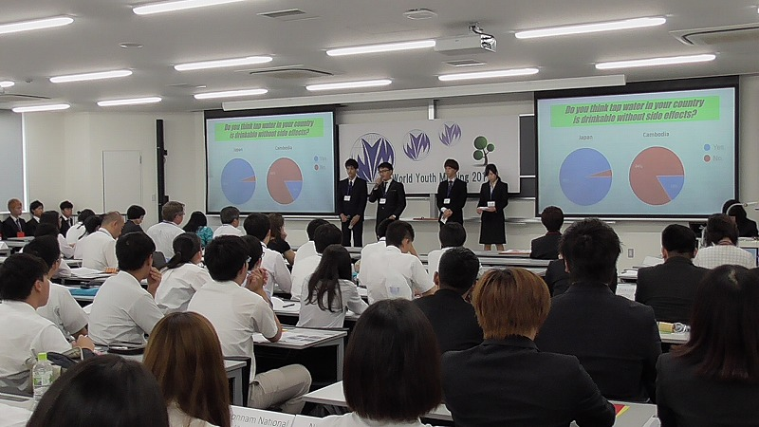
“Well-being” Activity World Youth Meeting
Notes:
This picture shows a “well-being” activity.
Happiness, globalization, collaboration, volunteerism, world peace, and education are all contained there.
This year we will welcome the 20th anniversary of the World Youth Meeting.
The World Youth Meeting has been a place where Japanese students have pursued an international volunteer spirit.
They have also deepened their friendships with students from overseas.
The WYM is an authentic setting that contains the theme of “well-being”.
This event has been supported by the Ministry of Education in Japan and many Asian countries.
This year, looking towards our shared future, we would like to discuss the broader range of the meaning of “well-being” in this unique setting.
What things are related to “well-being” in our daily life?
How should we act to in order to create a world society full of happiness?
Is the sense of “well-being” similar or more diverse in different parts of the world?
If some people do not have a sense of “well-being,” what is missing in their community?
What actions can be taken to make the community a better place to live?

Slide 4
Exploring the Theme
1. Healthy Life
2. Designing your Life
3. Meaning of your Life
Notes:
I hope you all understand the concept of “well-being”
The participants are invited to start exploring the theme.
They are expected to consider the following three essential issues.
These may enable people to have a stronger sense of well-being.
1. Healthy Life --- Mental and physical health
2. Designing your Life --- A stable income and open opportunities for education
3. Meaning of your Life --- Having opportunities to interact with people and make contributions to our communities
That’s all, thank you very much.

